Slide 1

Ramrao Adik Institute of Technology
Department of Computer Engineering
TE Mini Project Mock 1 Presentation
On
“Sign Language Recognition using Convolution Neural Network”
By
19CE5503 Kunal Kamble
Guided by
Name of Guide

Slide 2
Outline
Introduction
Literature Survey of existing system
Limitations of existing system
Problem Implementation
References

Slide 3
Introduction
The number of deaf-mutes in the country are roughly calculated between 1.8 million and 7 million. (The wide range in population estimates exists because the Indian census doesn’t track the number of deaf people — instead, it documents an aggregate number of people with disabilities.)
Sign language substantially facilitates communication to people with such disability.
However, there are only 2,50,000-5,00,000 speakers which significantly limits the number of people that they can easily communicate with.
In order to diminish this obstacle and to enable dynamic communication, we present an sign language recognition system that uses Convolutional Neural Networks (CNN) in real time to translate a video of a user’s ASL signs fingerspelling into text.
Our problem consists of three tasks to be done in real time:
Obtaining video of the user signing (input).
Classifying each frame in the video to a letter.
Reconstructing and displaying the most likely word from classification scores (output).

Slide 4
Literature Survey of existing system
Sign language recognition is a topic which has been addressed multiple times and is not new.
Over the last few years, different classifiers have been applied to solve this problem including linear classifiers, neural networks and Bayesian networks.
Singha and Das obtained accuracy of 96% on 10 classes for images of gestures of one hand using Karhunen-Loeve Transforms.
Starner and Pentland used a Hidden Markov Model (HMM) and a 3-D glove that tracks hand movement.
Since the glove is able to obtain 3-D information from the hand regardless of spatial orientation, they were able to achieve an impressive accuracy of 99.2% on the test set.
The most relevant work to date is L. Pigou et al’s application of CNN’s to classify 20 Italian gestures from the ChaLearn 2014 Looking at People gesture spotting competition.
They use a Microsoft Kinect on full body images of people performing the gestures and achieve a cross-validation accuracy of 91.7%.

Slide 5
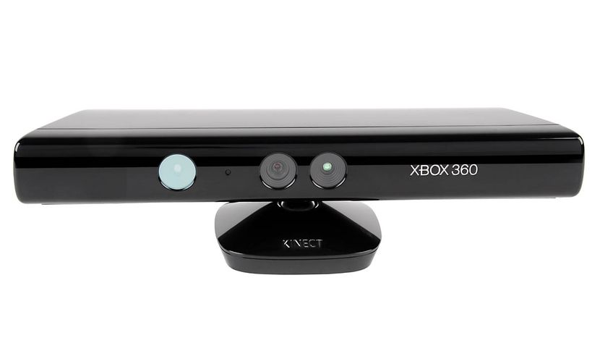
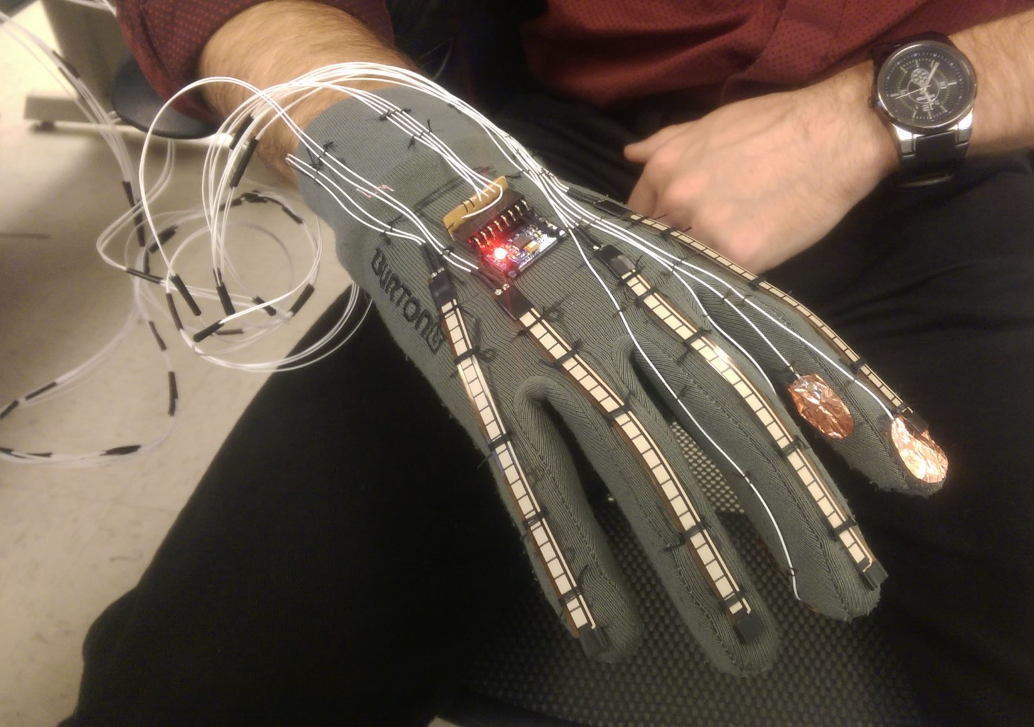
Limitations of existing system
Most of the existing systems require a High-Tech glove with motion sensors to capture the gesture in 3 dimensions or even a Microsoft Kinect, both of which are pretty expensive.
These also impose scalability issues due to the equipment dependency.
Benefits of portability has to be compromised, with the equipment having to be carried everywhere where the system is to be used.
Microsoft Kinect
Motion sensor gloves

Slide 6
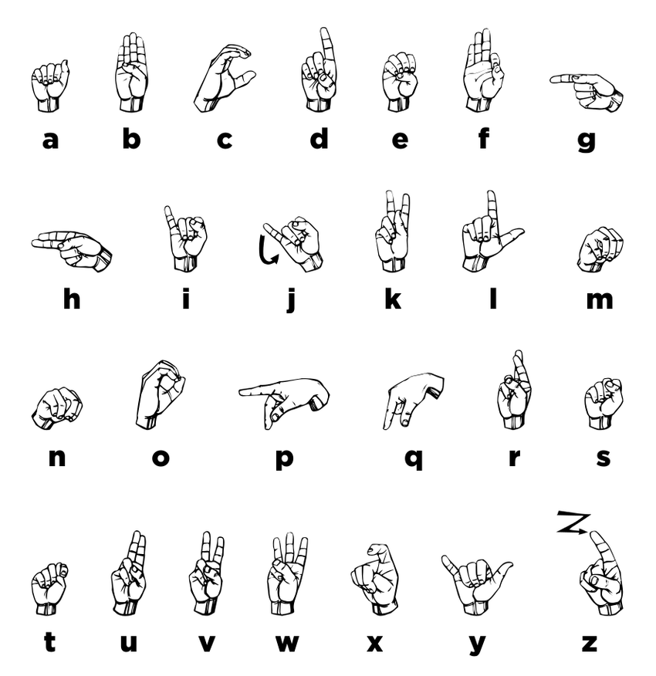
Problem Implementation
The system is a vision based approach. All the signs are represented with bare hands and so it eliminates the problem of using any artificial devices for interaction.
The problem implementation can be divided into two parts:
Data Set Generation
Gesture Classification
Data Set Generation :

Slide 7
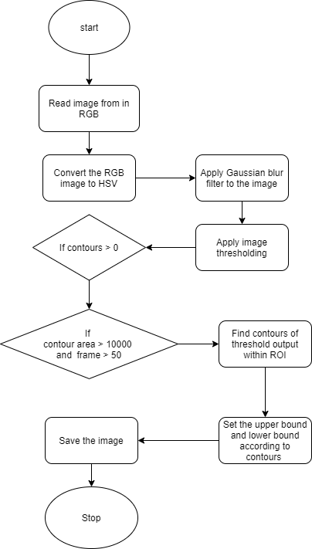
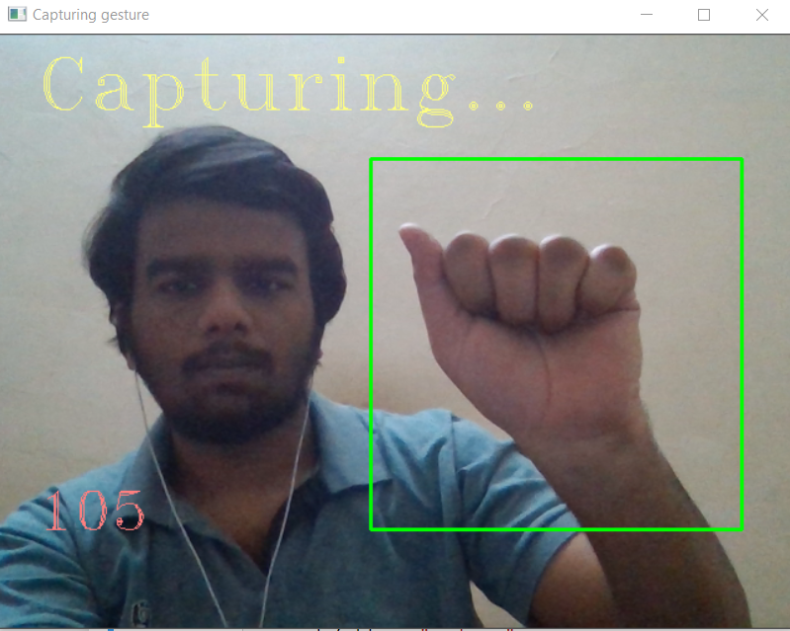
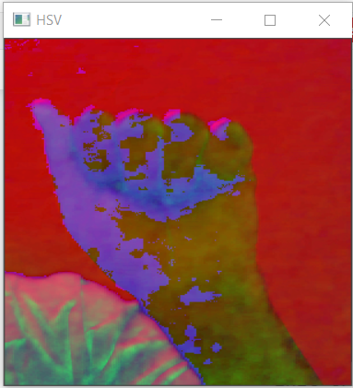
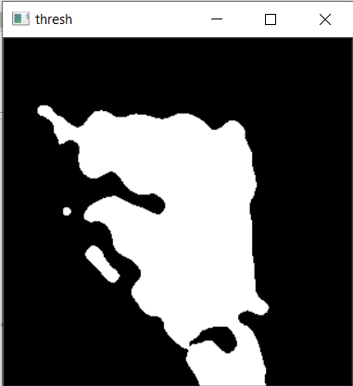
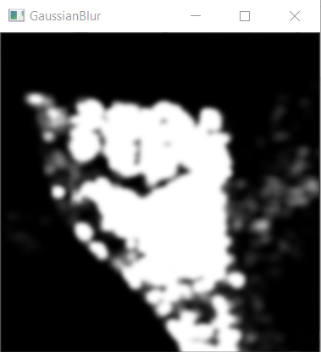
Image Pre-processing:

Slide 8
Gesture Classification:
Apply gaussian blur filter and threshold to the frame taken with opencv to get the processed image after feature extraction.
This processed image is passed to the CNN model for prediction and if a letter is detected for more than 50 frames then the letter is printed and taken into consideration for forming the word.
Space between the words and backspaces are considered using a custom gesture.

Slide 9
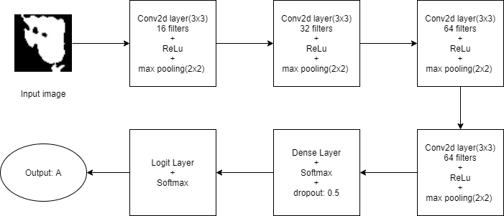
CNN Model:

Slide 10
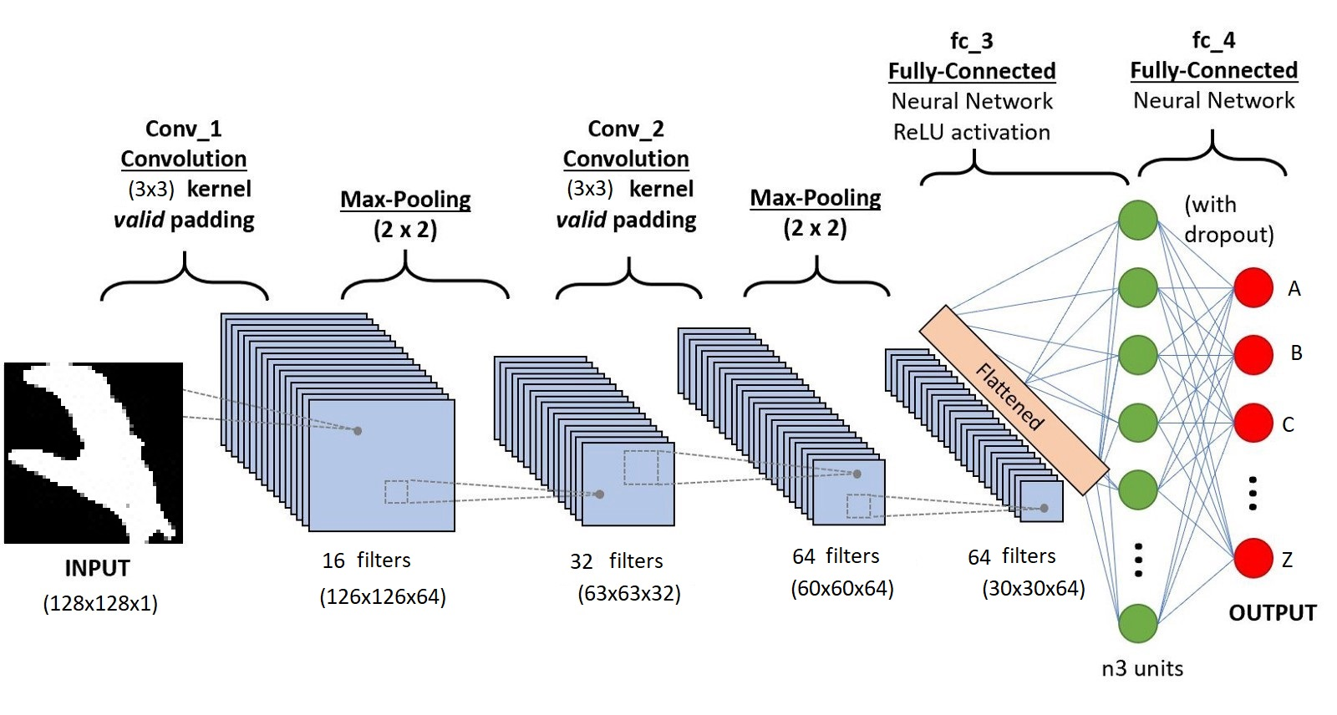

Convolution layer: The input image is processed through each convolution layer using the filter size of 3x3 having weights 16, 32, 64, 64.
Pooling Layer : We apply Max pooling to the input image with a pool size of (2, 2) with relu activation function. This reduces the amount of parameters thus lessening the computation cost and reduces overfitting.

Slide 11
ReLu activation Function : We use ReLu (Rectified Linear Unit) in each of the layers. ReLu calculates max(x,0) for each input pixel. This adds nonlinearity to the formula and helps to learn more complicated features. It helps in removing the vanishing gradient problem and speeding up the training by reducing the computation time.
Dropout Layers: The problem of overfitting, where after training, the weights of the network are so tuned to the training examples they are given that the network doesn’t perform well when given new examples. This layer “drops out” a random set of activations in that layer by setting them to zero. The network should be able to provide the right classification or output for a specific example even if some of the activations are dropped out.
Softmax activation function: The function is great for classification problems, especially if you’re dealing with multi-class classification problems, as it will report back the “confidence score” for each class.

Slide 12
References
Brandon Garcia, Sigberto Alarcon Viesca “Real-time American Sign Language Recognition with Convolutional Neural Networks”, (2017).
Rao, G. A., Syamala, K., Kishore, P. V. V., Sastry, A. S. C. S. “Deep convolutional neural networks for sign language recognition”, (2018).
Teena Varma, Ricketa Baptista, Daksha Chithirai Pandi, Ryland Coutinho “Sign Language Detection using Image Processing and Deep Learning”, (2020).
A Comprehensive Guide to Convolutional Neural Networks — the ELI5 way | by Sumit Saha | Towards Data Science

Slide 13
Thank You

